Slide 1
Introducing R
Intro to R Workshop – Alfred Campus October 19 2017
Trainers – Adele Barugahare, Haroon Naeem, Nick Wong
Helpers – Kevin Gillinder, Antony Kaspi, Graham Magor, Haloom Rafehi, Mark Ziemann

Slide 2
Today’s Objective(s) – What we hope you will get out of today
Introduction to R
The basics of R – data objects
Data plotting
How to find more information for a specific task
The start of the journey, a network of R learners/users around you.
Entry into more advanced and specialised uses of R for your research.

Slide 3
Why R? (as opposed to Excel?)
It’s free
Reproducible analysis
Documenting what you have done with your data.
Come back to it days, months, years and you should know what was done.
Low risk of inadvertent data loss/mutation.
By design, R requires you to load your data in, what you do with the data is written in the code.
R can handle really large datasets
Excel is limited by 1,048,576 rows and 16,384 columns
Collaborative
Share your data and analysis.

Slide 4
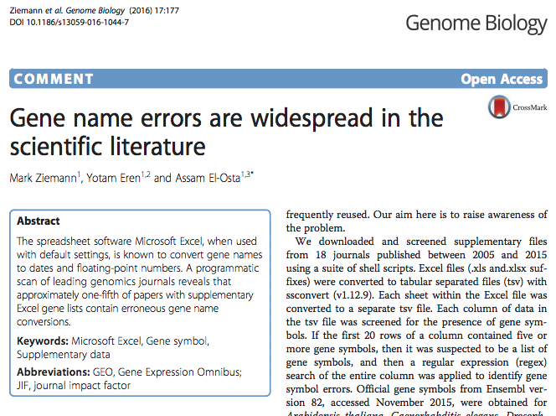
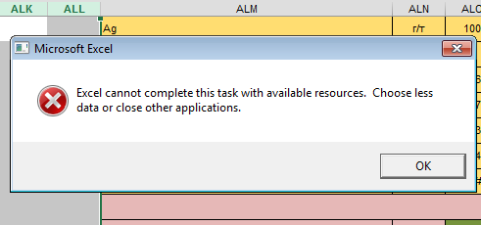
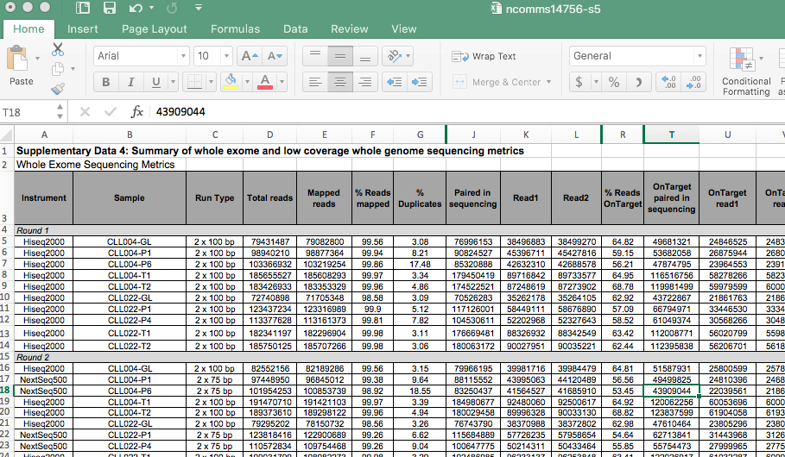
Why R? (as opposed to Excel?)
Typo and saved it

Slide 5
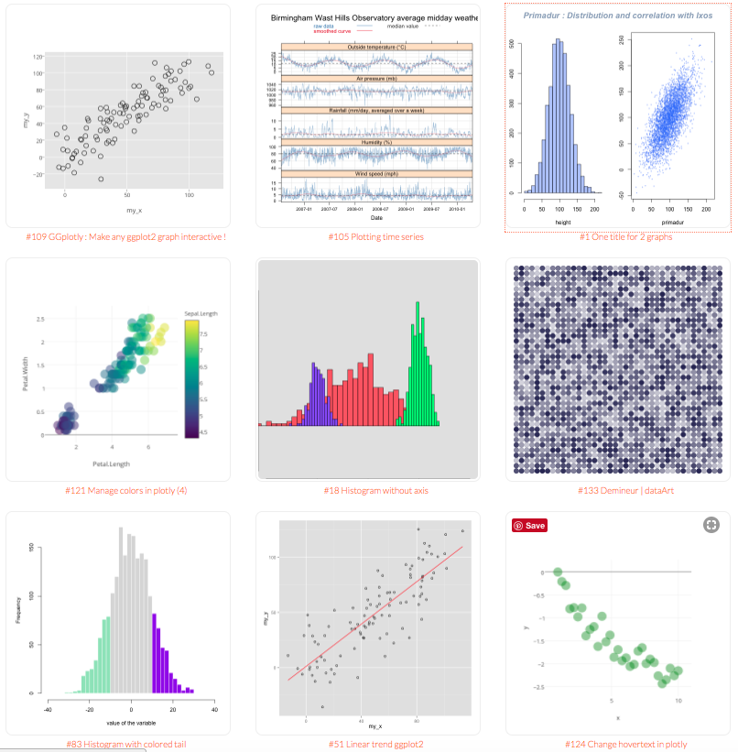
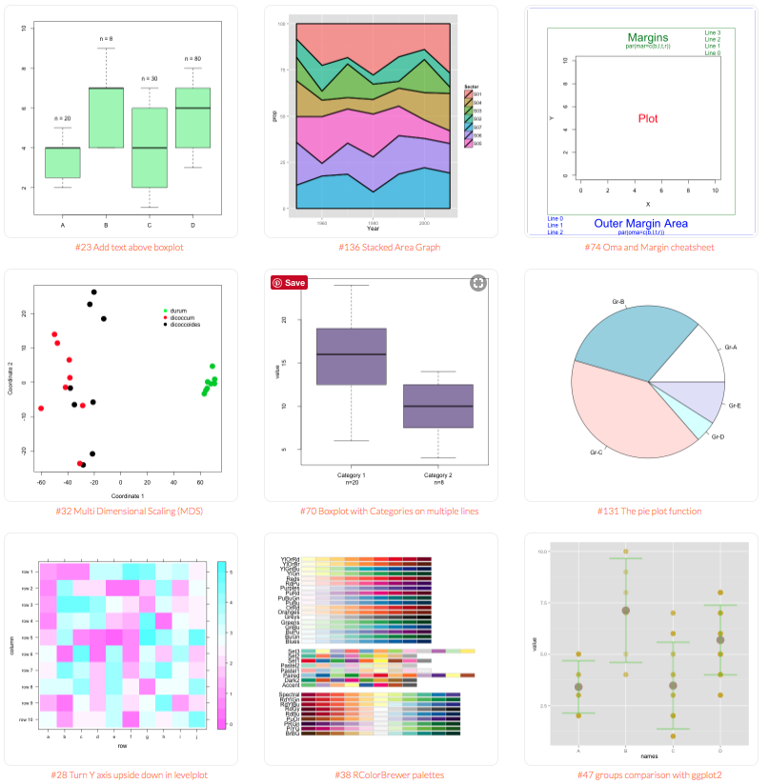
Why R? (as opposed to Excel?)
Graphs and plotting.
Can you plot a box and whisker plot in excel?
http://www.r-graph-gallery.com/

Slide 6
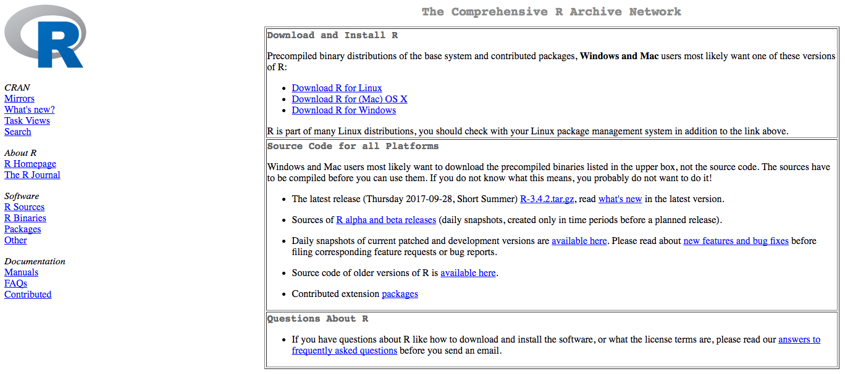
How to get R?
Many specialised tools/libraries for specific purposes
Collection of functions
https://cran.r-project.org/

Slide 7
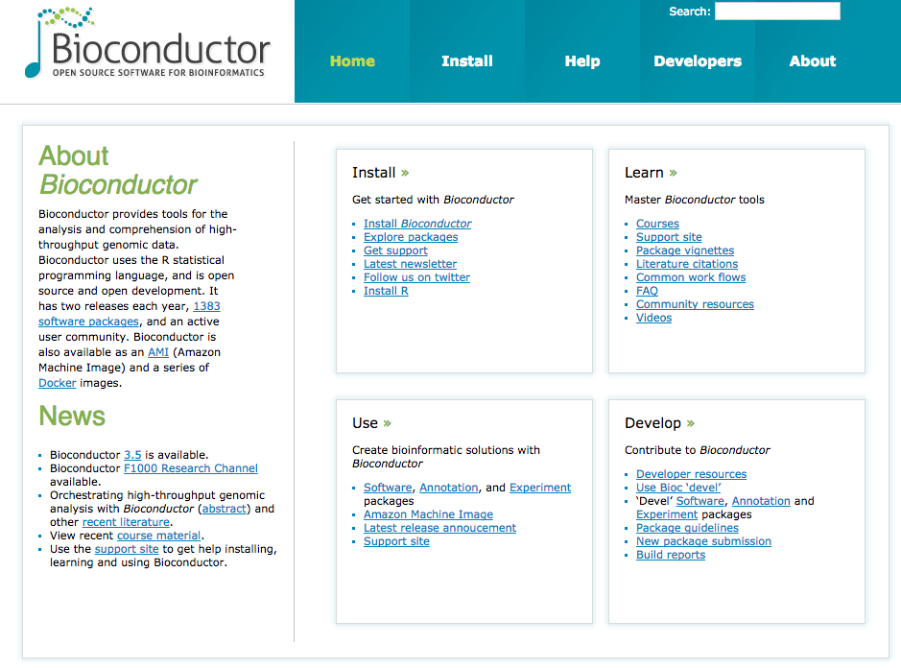
Tools and libraries used in R?
Bioconductor, source for most bioinformatics libraries and tools for R. Home of LIMMA.
Defined rules.
Good documentation.
Worked examples.
https://www.bioconductor.org/

Slide 8
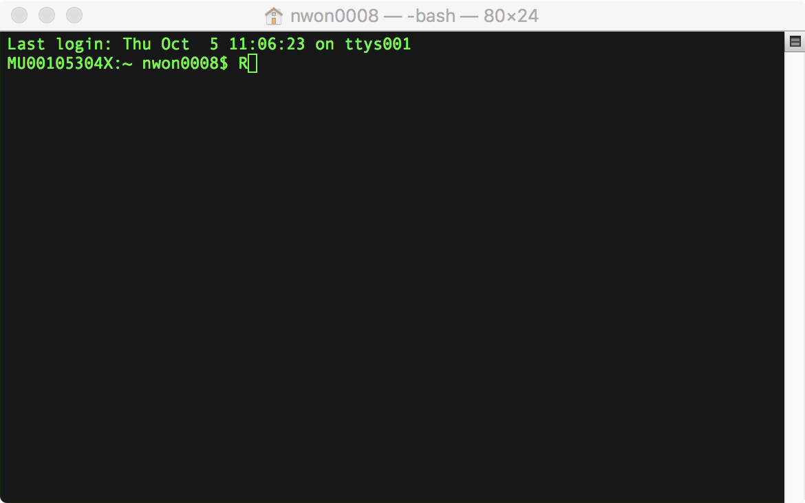
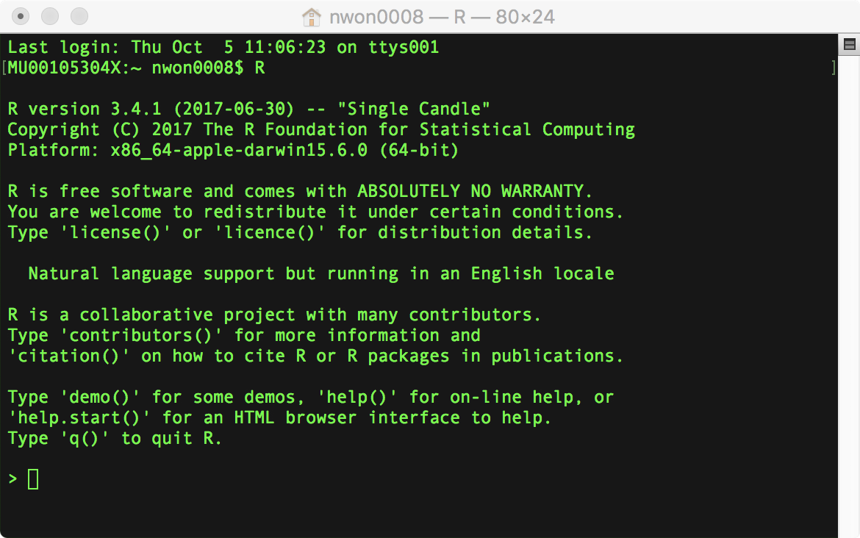
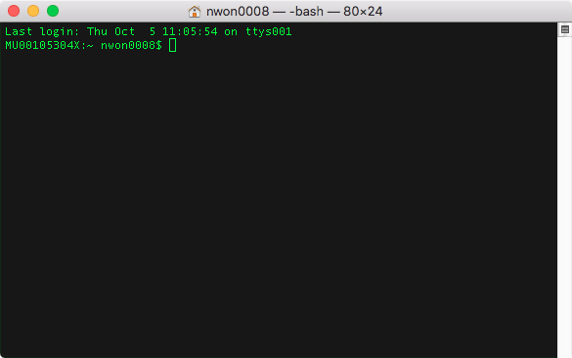
R and the interfaces to R
R on the command line

Slide 9
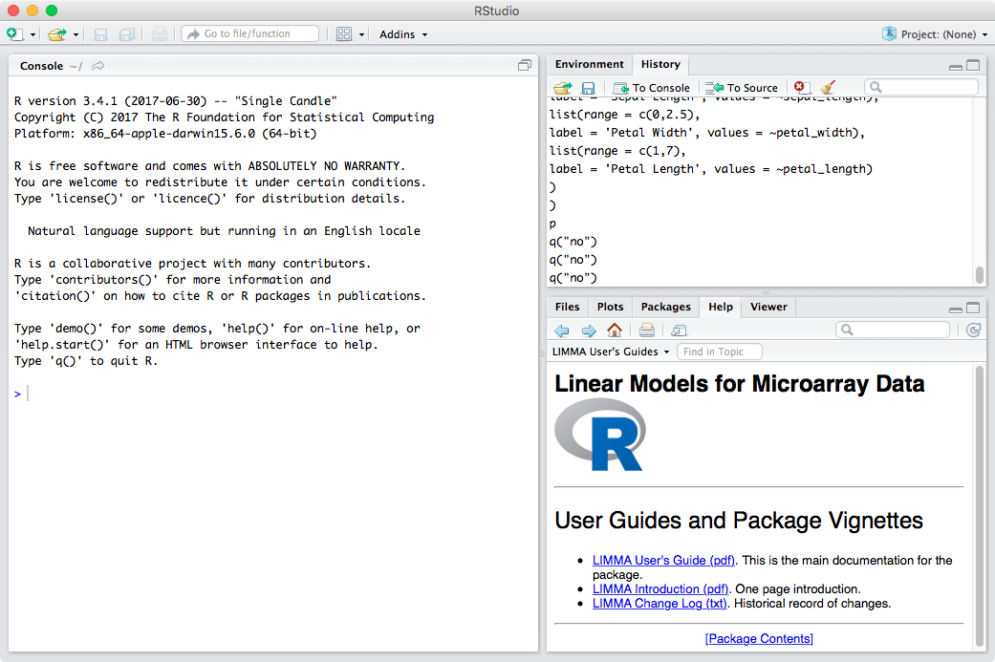
R and the interfaces of R
RStudio – RStudio Server, a graphical interface to R
https://www.rstudio.com/

Slide 10
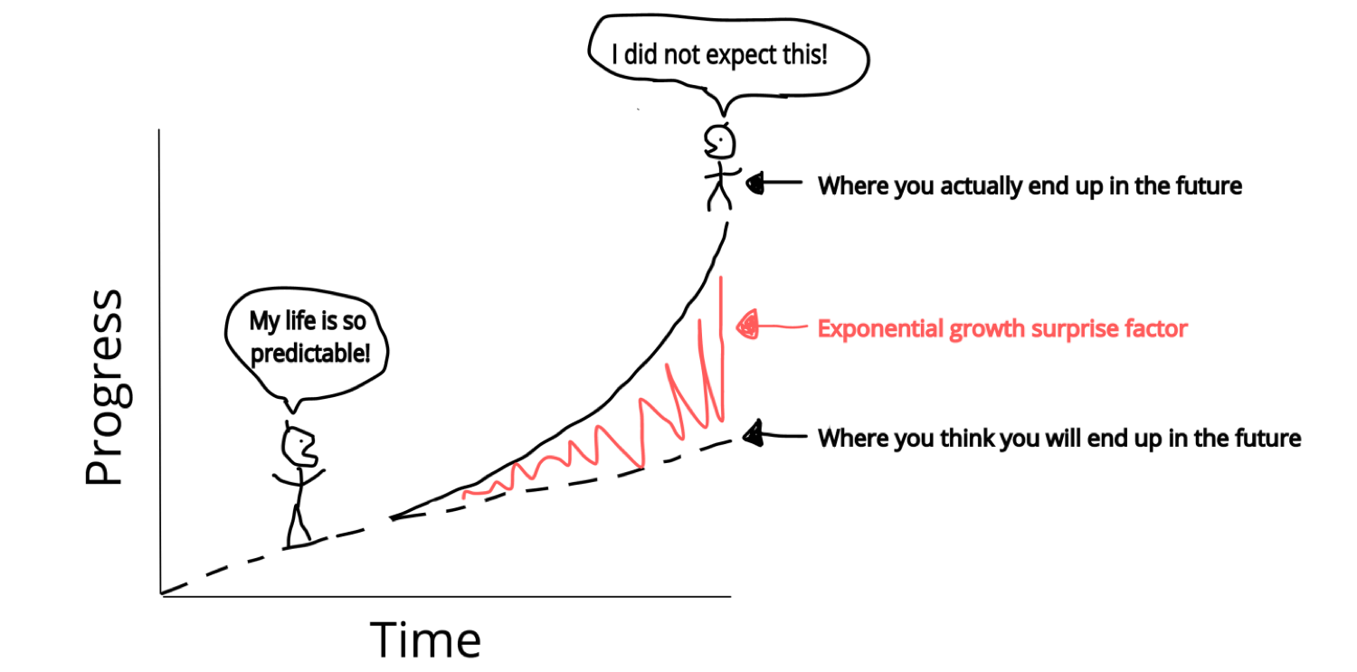
Today – Intro to R
Starting out in R - Adele
Working with data in a matrix - Adele
Working with data in a data frame - Nick
For loops - Haroon
Plotting with ggplot2 - Haroon

Slide 11
How the workshop works – signaling for help
Sticky notes
I need help!
I am all good.

Slide 12
Google Docs for communication and submitting answer to challenges

Slide 13
Rounding up
This is the start of your R journey, many others are at the same stage, share your questions.
Encourage to attend this workshop again and others we offer.
R-more
Advanced R
MBP offer a Friday help session at Clayton @3:30pm for drop in questions. To be determined for Alfred. (or, contact Nick).
Vamos!

